Slide 1
Coordinate System
Hung-yi Lee

Slide 2
Outline
Coordinate Systems
Each coordinate system is a “viewpoint” for vector representation.
The same vector is represented differently in different coordinate systems.
Different vectors can have the same representation in different coordinate systems.
Changing Coordinates
Reference: textbook Ch 4.4

Slide 3
Coordinate System

Slide 4
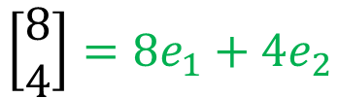







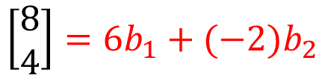






Vector
New Coordinate System
$$b_{1}=\left[\begin{aligned}1 \\ 1\end{aligned}\right]$$
$$b_{2}=\left[\begin{aligned}−1 \\ 1\end{aligned}\right]$$
{e₁, e₂} is a coordinate system
$${6b}_{1}$$
$$\left[\begin{aligned}8 \\ 4\end{aligned}\right]$$
$$\left[\begin{aligned}8 \\ 4\end{aligned}\right]$$
$${4e}_{2}$$
$$\left[\begin{aligned}6 \\ −2\end{aligned}\right]$$
$$b_{1}$$
$$e_{2}$$
$$b_{2}$$
$$e_{1}$$
$${8e}_{1}$$
$${−2b}_{2}$$
$$\left[\begin{aligned}8 \\ 4\end{aligned}\right]=8e_{1}+4e_{2}$$
$$\left[\begin{aligned}8 \\ 4\end{aligned}\right]=6b_{1}+(−2)b_{2}$$

Slide 5



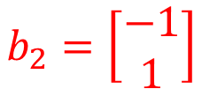
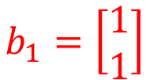

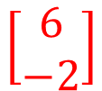

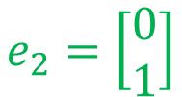



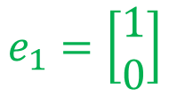
Vector
$$\left[\begin{aligned}8 \\ 4\end{aligned}\right]$$
$$\left[\begin{aligned}6 \\ −2\end{aligned}\right]$$
drink
home
$$e_{2}$$
$$b_{1}$$
$$b_{2}$$
$$e_{1}$$
$$e_{1}=\left[\begin{aligned}1 \\ 0\end{aligned}\right]$$
$$e_{2}=\left[\begin{aligned}0 \\ 1\end{aligned}\right]$$
$$b_{1}=\left[\begin{aligned}1 \\ 1\end{aligned}\right]$$
$$b_{2}=\left[\begin{aligned}−1 \\ 1\end{aligned}\right]$$

Slide 6
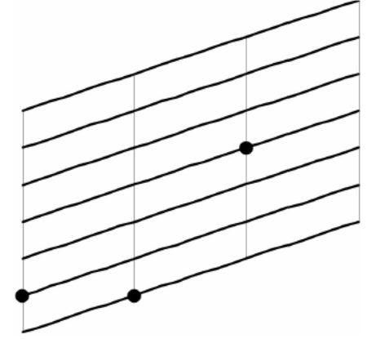
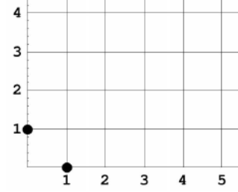
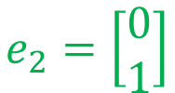

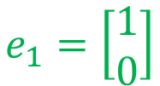

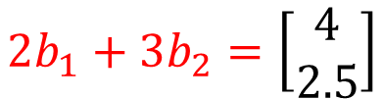
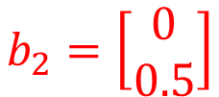

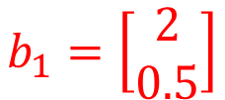




Vector
$$e_{1}=\left[\begin{aligned}1 \\ 0\end{aligned}\right]$$
$$e_{2}=\left[\begin{aligned}0 \\ 1\end{aligned}\right]$$
$$b_{1}=\left[\begin{aligned}2 \\ 0.5\end{aligned}\right]$$
$$b_{2}=\left[\begin{aligned}0 \\ 0.5\end{aligned}\right]$$
$$\left[\begin{aligned}2 \\ 3\end{aligned}\right]$$
$$\left[\begin{aligned}2 \\ 3\end{aligned}\right]$$
$\left[\begin{aligned}4 \\ 2.5\end{aligned}\right]$ for left
$$e_{2}$$
$$b_{2}$$
$$b_{1}$$
$$e_{1}$$
$$2b_{1}+3b_{2}=\left[\begin{aligned}4 \\ 2.5\end{aligned}\right]$$

Slide 7
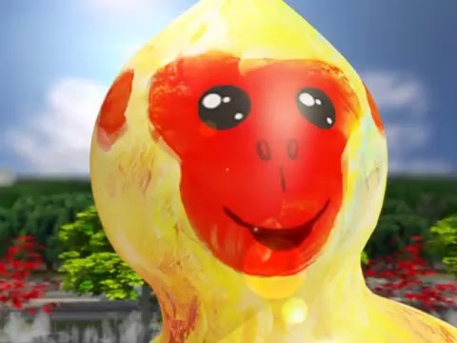
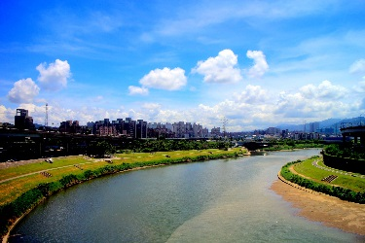
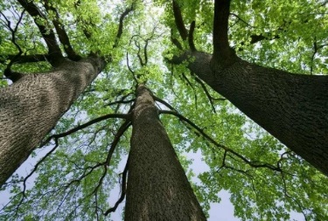
Vector
$$e_{1}=\left[\begin{aligned}1 \\ 0\end{aligned}\right]$$
$$e_{2}=\left[\begin{aligned}0 \\ 1\end{aligned}\right]$$
$$b_{1}=\left[\begin{aligned}2 \\ 0.5\end{aligned}\right]$$
$$b_{2}=\left[\begin{aligned}0 \\ 0.5\end{aligned}\right]$$
$$\left[\begin{aligned}2 \\ 3\end{aligned}\right]$$
home
$$\left[\begin{aligned}2 \\ 3\end{aligned}\right]$$
home
$\left[\begin{aligned}4 \\ 2.5\end{aligned}\right]$ for left
$$e_{2}$$
$$b_{2}$$
$$b_{1}$$
$$e_{1}$$
$$2b_{1}+3b_{2}=\left[\begin{aligned}4 \\ 2.5\end{aligned}\right]$$

Slide 8

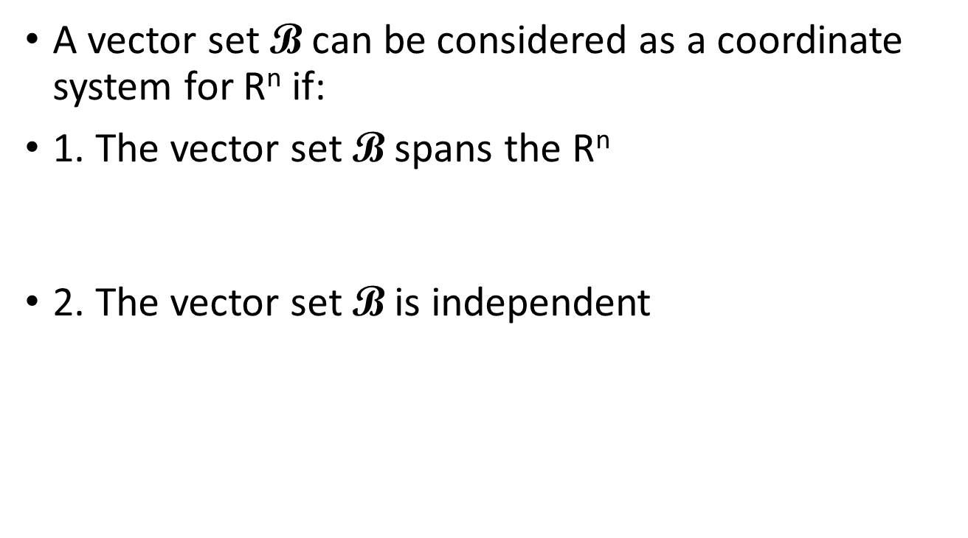
Coordinate System
A vector set $\text{B}$ can be considered as a coordinate system for R^{n} if:
1. The vector set $\text{B}$ spans the R^{n}
2. The vector set $\text{B}$ is independent
Every vector should have representation
Unique representation
$\text{B}$ is a basis of R^{n}

Slide 9

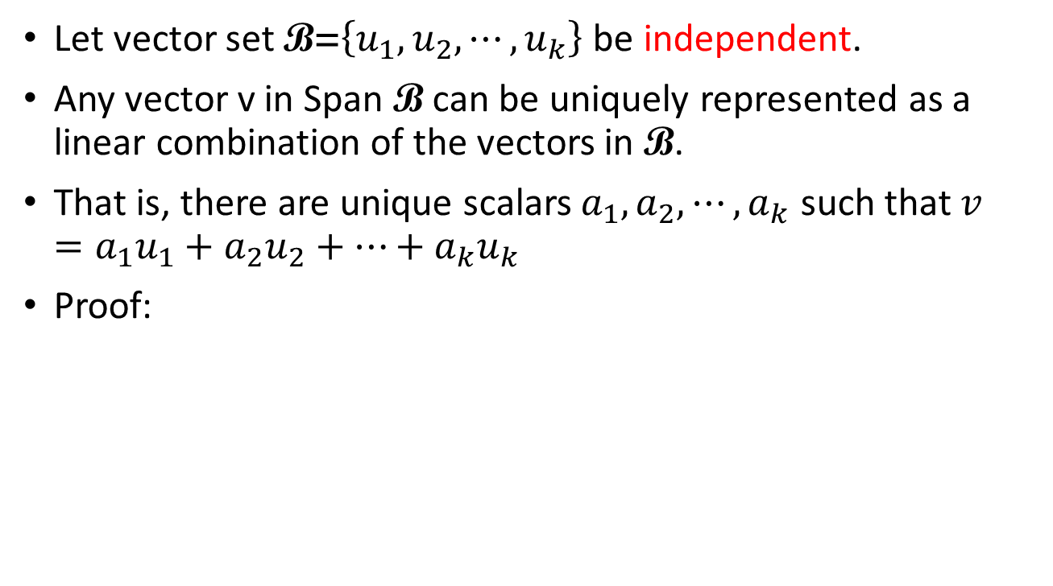

Why Basis?
Let vector set $\text{B}\text{=}\left\{u_{1},u_{2},⋯,u_{k}\right\}$ be independent.
Any vector v in Span $\text{B}$ can be uniquely represented as a linear combination of the vectors in $\text{B}$.
That is, there are unique scalars $a_{1},a_{2},⋯,a_{k}$ such that $v=a_{1}u_{1}+a_{2}u_{2}+⋯+a_{k}u_{k}$
Proof:
Unique?
$$v=a_{1}u_{1}+a_{2}u_{2}+⋯+a_{k}u_{k}$$
$$v=b_{1}u_{1}+b_{2}u_{2}+⋯+b_{k}u_{k}$$
$$\left({a_{1}−b}_{1}\right)u_{1}+\left({a_{2}−b}_{2}\right)u_{2}+⋯+\left({a_{k}−b}_{k}\right)u_{k}=0$$
B is independent
a₁ − b₁ = a₂ − b₂ = ☹ = a_{k} − b_{k} = 0

Slide 10
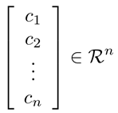




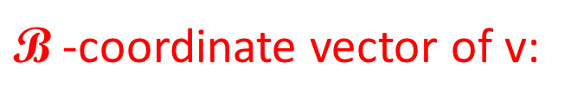
Coordinate System
Let vector set $\text{B}\text{=}\left\{u_{1},u_{2},⋯,u_{n}\right\}$ be a basis for a subspace R^{n}
For any v in R^{n}, there are unique scalars $c_{1},c_{2},⋯,c_{n}$ such that $v=c_{1}u_{1}+c_{2}u_{2}+⋯+c_{n}u_{n}$
$\text{B}$ is a coordinate system
$\text{B}$-coordinate vector of v:
$${\left[v\right]}_{\text{B}}=$$
(用 $\text{B}$ 的觀點來看原來的 v)
Notes:
$$\text{(}\text{某種觀點}\text{)}$$
根據某種觀點所看到的結果

Slide 11





Coordinate System
vector
$$\text{B}\text{=}\left\{u_{1},u_{2},⋯,u_{n}\right\}$$
$${\left[v\right]}_{\text{B}}$$
vector
$$\text{E}\text{=}\left\{e_{1},e_{2},⋯,e_{n}\right\}$$
(standard vectors)
$\text{E}$ is Cartesian coordinate system
(直角坐標系)
$v={\left[v\right]}_{\text{E}}$

Slide 12
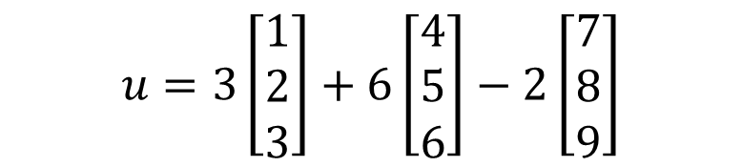
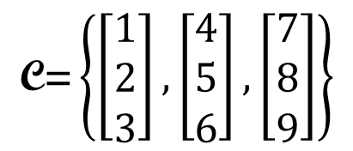

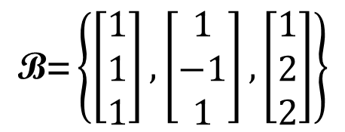
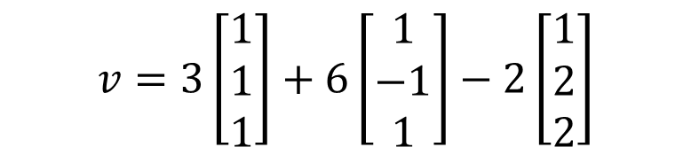
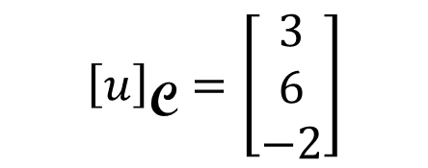
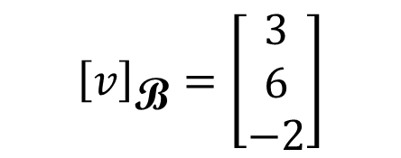

Other System → Cartesian
$$\text{B}\text{=}\left\{\left[\begin{aligned}1 \\ 1 \\ 1\end{aligned}\right],\left[\begin{aligned}1 \\ −1 \\ 1\end{aligned}\right],\left[\begin{aligned}1 \\ 2 \\ 2\end{aligned}\right]\right\}$$
$${\left[v\right]}_{\text{B}}=\left[\begin{aligned}3 \\ 6 \\ −2\end{aligned}\right]$$
$$=\left[\begin{aligned}7 \\ −7 \\ 5\end{aligned}\right]$$
$$v=3\left[\begin{aligned}1 \\ 1 \\ 1\end{aligned}\right]+6\left[\begin{aligned}1 \\ −1 \\ 1\end{aligned}\right]−2\left[\begin{aligned}1 \\ 2 \\ 2\end{aligned}\right]$$
$$\text{C}\text{=}\left\{\left[\begin{aligned}1 \\ 2 \\ 3\end{aligned}\right],\left[\begin{aligned}4 \\ 5 \\ 6\end{aligned}\right],\left[\begin{aligned}7 \\ 8 \\ 9\end{aligned}\right]\right\}$$
$${\left[u\right]}_{\text{C}}=\left[\begin{aligned}3 \\ 6 \\ −2\end{aligned}\right]$$
$$=\left[\begin{aligned}13 \\ 20 \\ 27\end{aligned}\right]$$
$$u=3\left[\begin{aligned}1 \\ 2 \\ 3\end{aligned}\right]+6\left[\begin{aligned}4 \\ 5 \\ 6\end{aligned}\right]−2\left[\begin{aligned}7 \\ 8 \\ 9\end{aligned}\right]$$

Slide 13
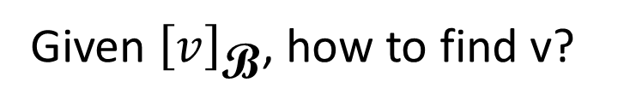




Other System → Cartesian
Let vector set $\text{B}\text{=}\left\{u_{1},u_{2},⋯,u_{n}\right\}$ be a basis for a subspace R^{n}
Matrix $B=\left[\begin{matrix}\begin{matrix}u_{1} & u_{2}\end{matrix} & \begin{matrix}⋯ & u_{n}\end{matrix}\end{matrix}\right]$
$${\left[v\right]}_{\text{B}}=\left[\begin{aligned}c_{1} \\ c_{2} \\ ⋮ \\ c_{n}\end{aligned}\right]$$
Given ${\left[v\right]}_{\text{B}}$, how to find v?
$$v=c_{1}u_{1}+c_{2}u_{2}+⋯+c_{n}u_{n}$$
$=B{\left[v\right]}_{\text{B}}$
(matrix-vector product)

Slide 14
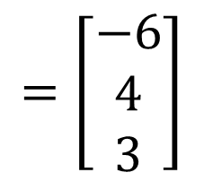
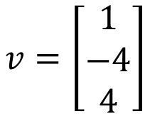


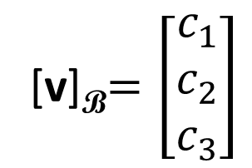
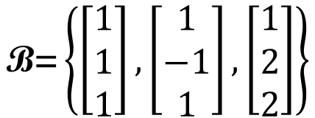
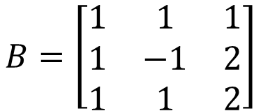
Cartesian → Other System
$$v=\left[\begin{aligned}1 \\ −4 \\ 4\end{aligned}\right]$$
$$\text{B}\text{=}\left\{\left[\begin{aligned}1 \\ 1 \\ 1\end{aligned}\right],\left[\begin{aligned}1 \\ −1 \\ 1\end{aligned}\right],\left[\begin{aligned}1 \\ 2 \\ 2\end{aligned}\right]\right\}$$
find [v]_{B}
[v]_{B}$=\left[\begin{aligned}c_{1} \\ c_{2} \\ c_{3}\end{aligned}\right]$
$$B=\left[\begin{matrix}1 & 1 & 1 \\ 1 & −1 & 2 \\ 1 & 1 & 2\end{matrix}\right]$$
B is invertible (?)
independent
$$=\left[\begin{aligned}−6 \\ 4 \\ 3\end{aligned}\right]$$
$$B{\left[v\right]}_{\text{B}}=v$$
$${\left[v\right]}_{\text{B}}=B^{−1}v$$

Slide 15

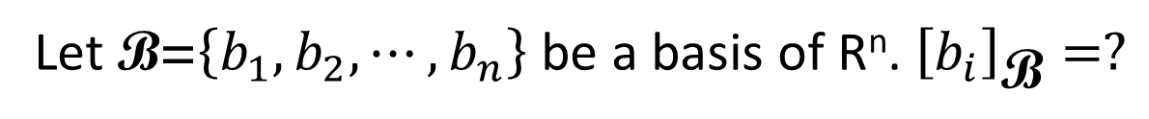






Cartesian $↔$ Other System
Let B = {b₁ , b₂ , 😐, b_{n}}
$${\left[v\right]}_{\text{B}}=B^{−1}v$$
$$v$$
$${\left[v\right]}_{\text{B}}$$
$$=\left[\begin{aligned}c_{1} \\ c_{2} \\ ⋮ \\ c_{n}\end{aligned}\right]$$
$$v=B{\left[v\right]}_{\text{B}}$$
= c₁b₁ + c₂b₂ + ☹ + c_{n}b_{n}
Let $\text{B}\text{=}\left\{b_{1},b_{2},⋯,b_{n}\right\}$ be a basis of R^{n}. ${\left[b_{i}\right]}_{\text{B}}=?$
$$e_{i}$$
(Standard vector)

Slide 16
Changing Coordinates

Slide 17
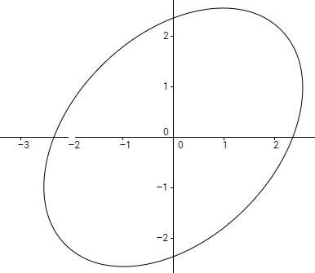
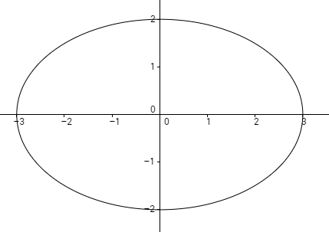
Equation of ellipse
Rotate 45◦
2
2
3
3
?
Notes:
Draw by
http://web.geogebra.org/app/

Slide 18

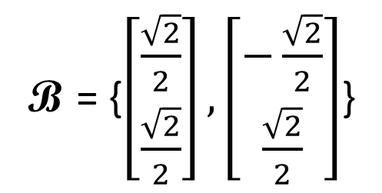



Equation of ellipse
Use another coordinate system
$$b_{1}$$
$$b_{2}$$
B = {$\left[\begin{aligned}\frac{\sqrt{2}}{2} \\ \frac{\sqrt{2}}{2}\end{aligned}\right],\left[\begin{aligned}−\frac{\sqrt{2}}{2} \\ \frac{\sqrt{2}}{2}\end{aligned}\right]$}
2
3
$$b_{2}$$
$$b_{1}$$
What is the equation of the ellipse in the new coordinate system?
Notes:
is

Slide 19


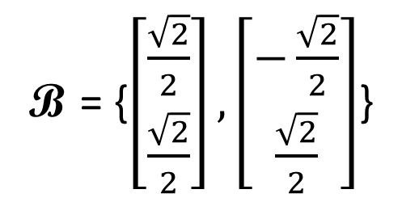
Equation of ellipse
B = {$\left[\begin{aligned}\frac{\sqrt{2}}{2} \\ \frac{\sqrt{2}}{2}\end{aligned}\right],\left[\begin{aligned}−\frac{\sqrt{2}}{2} \\ \frac{\sqrt{2}}{2}\end{aligned}\right]$}

Slide 20










Equation of hyperbola
$$y′$$
$$y′$$
$$y$$
$$x′$$
30◦
$$x$$
$$x′$$
$$−\sqrt{3}x^{2}+2xy+\sqrt{3}y^{2}=12$$
$$equation?$$

Slide 21







Equation of hyperbola
$$B=\left[\begin{matrix}b_{1} & b_{2}\end{matrix}\right]$$
$$y′$$
$$b_{1}=\left[\begin{aligned}\frac{\sqrt{3}}{2} \\ \frac{1}{2}\end{aligned}\right]$$
$$b_{2}=\left[\begin{aligned}−\frac{1}{2} \\ \frac{\sqrt{3}}{2}\end{aligned}\right]$$
$$y$$
$$x′$$
30◦
$$v=\left[\begin{aligned}x \\ y\end{aligned}\right]$$
$${\left[v\right]}_{\text{B}}=\left[\begin{aligned}x′ \\ y′\end{aligned}\right]$$
$$v={\text{B}\left[v\right]}_{\text{B}}$$
$$x$$
$$\left[\begin{aligned}x \\ y\end{aligned}\right]=\left[\begin{matrix}\frac{\sqrt{3}}{2} & −\frac{1}{2} \\ \frac{1}{2} & \frac{\sqrt{3}}{2}\end{matrix}\right]\left[\begin{aligned}x′ \\ y′\end{aligned}\right]$$
$$−\sqrt{3}x^{2}+2xy+\sqrt{3}y^{2}=12$$

Slide 22






Equation of hyperbola
$$B=\left[\begin{matrix}b_{1} & b_{2}\end{matrix}\right]$$
$$−\sqrt{3}x^{2}+2xy+\sqrt{3}y^{2}=12$$
$$b_{1}=\left[\begin{aligned}\frac{\sqrt{3}}{2} \\ \frac{1}{2}\end{aligned}\right]$$
$$b_{2}=\left[\begin{aligned}−\frac{1}{2} \\ \frac{\sqrt{3}}{2}\end{aligned}\right]$$
$$x=\frac{\sqrt{3}}{2}x^{′}−\frac{1}{2}y^{′}$$
$$y=\frac{1}{2}x^{′}+\frac{\sqrt{3}}{2}y^{′}$$
$$v=\left[\begin{aligned}x \\ y\end{aligned}\right]$$
$${\left[v\right]}_{\text{B}}=\left[\begin{aligned}x′ \\ y′\end{aligned}\right]$$
$$v={\text{B}\left[v\right]}_{\text{B}}$$
$$x^{′}y^{′}=3$$
$$\left[\begin{aligned}x \\ y\end{aligned}\right]=\left[\begin{matrix}\frac{\sqrt{3}}{2} & −\frac{1}{2} \\ \frac{1}{2} & \frac{\sqrt{3}}{2}\end{matrix}\right]\left[\begin{aligned}x′ \\ y′\end{aligned}\right]$$

Slide 23







Summary
vector
$$\text{B}\text{=}\left\{u_{1},u_{2},⋯,u_{n}\right\}$$
$${\left[v\right]}_{\text{B}}$$
vector
$$\text{E}\text{=}\left\{e_{1},e_{2},⋯,e_{n}\right\}$$
(standard vectors)
$${\left[v\right]}_{\text{B}}=B^{−1}v$$
$$v$$
$${\left[v\right]}_{\text{B}}$$
$$v=B{\left[v\right]}_{\text{B}}$$

